Slide 1
Impacts of magnetic permeability on electromagnetic data collected in settings with steel-cased wells
Lindsey J. Heagy & Douglas W. Oldenburg
University of British Columbia - Geophysical Inversion Facility
3DEM-7 Symposium

Slide 2
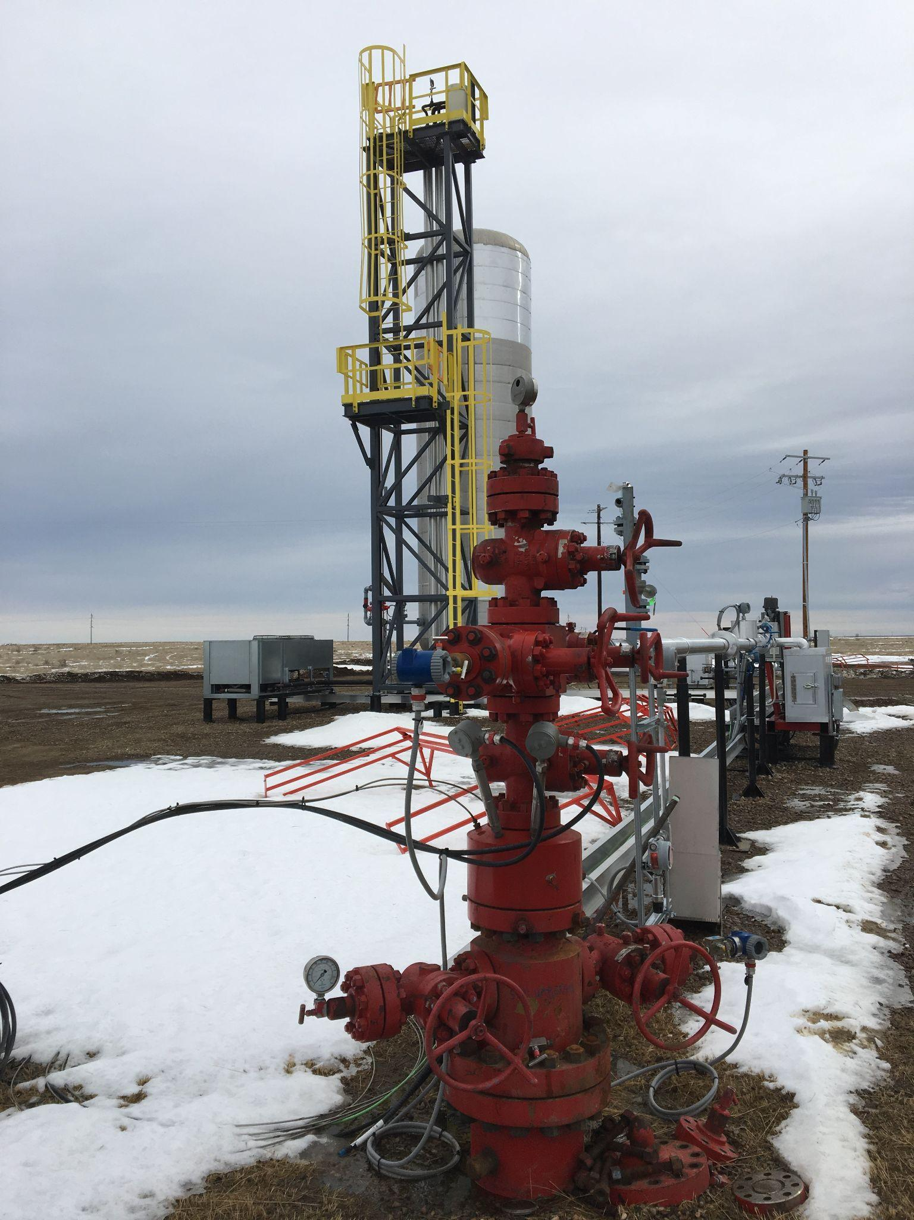
motivation
CO₂ sequestration
geothermal
hydrocarbons
wastewater injection
wellbore integrity
geophysics in urban settings
…

Slide 3
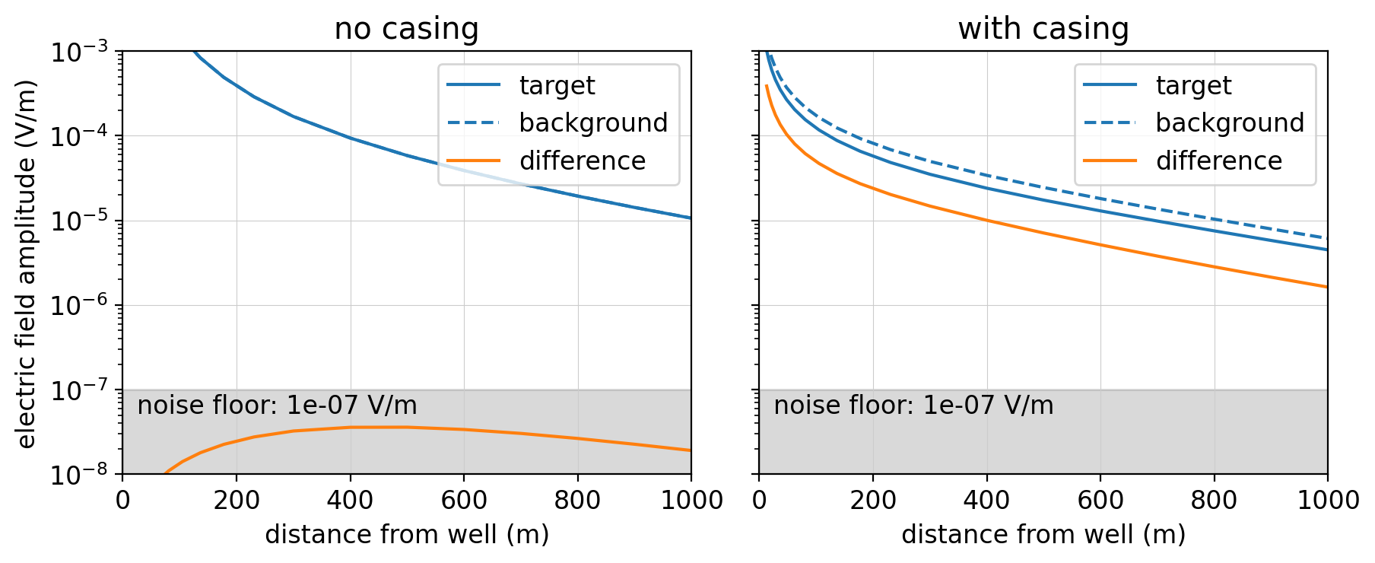
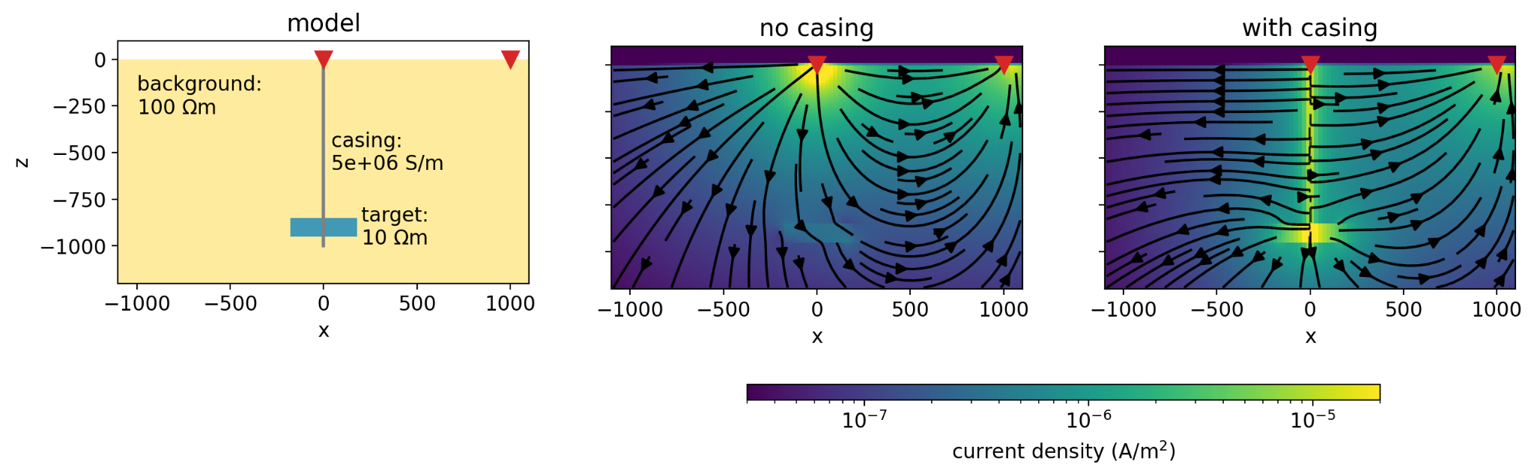
grounded source experiments
steel: highly conductive, magnetic
helps excite & detect targets at depth

Slide 4
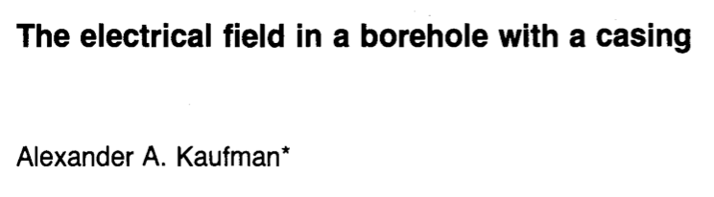
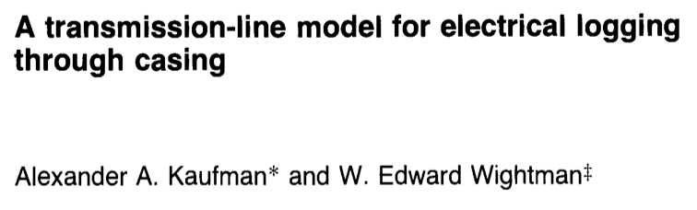
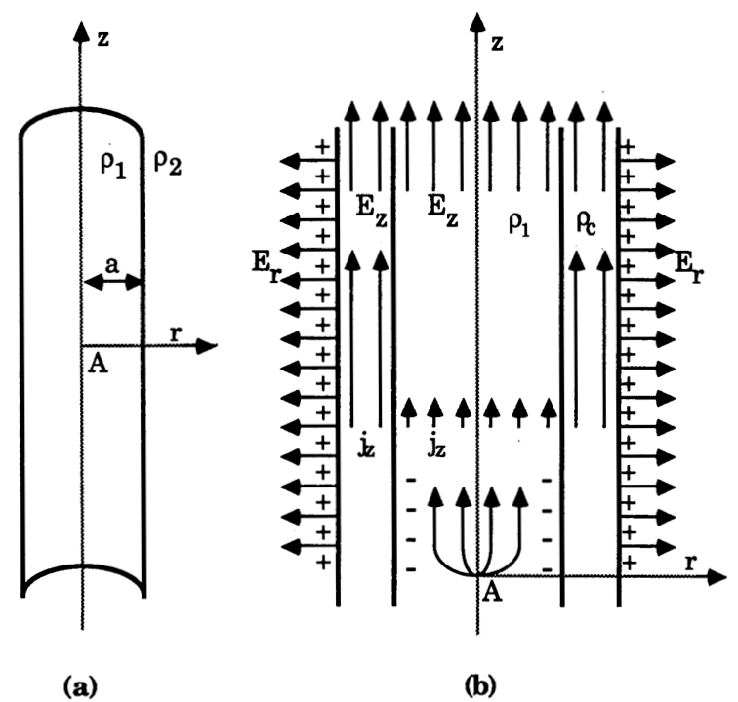
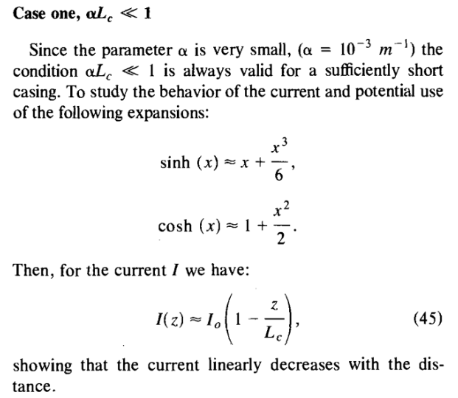
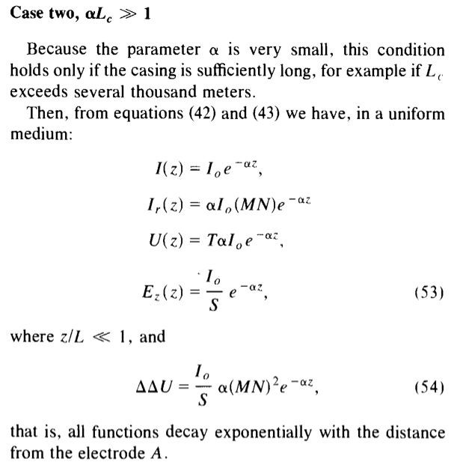

Slide 5
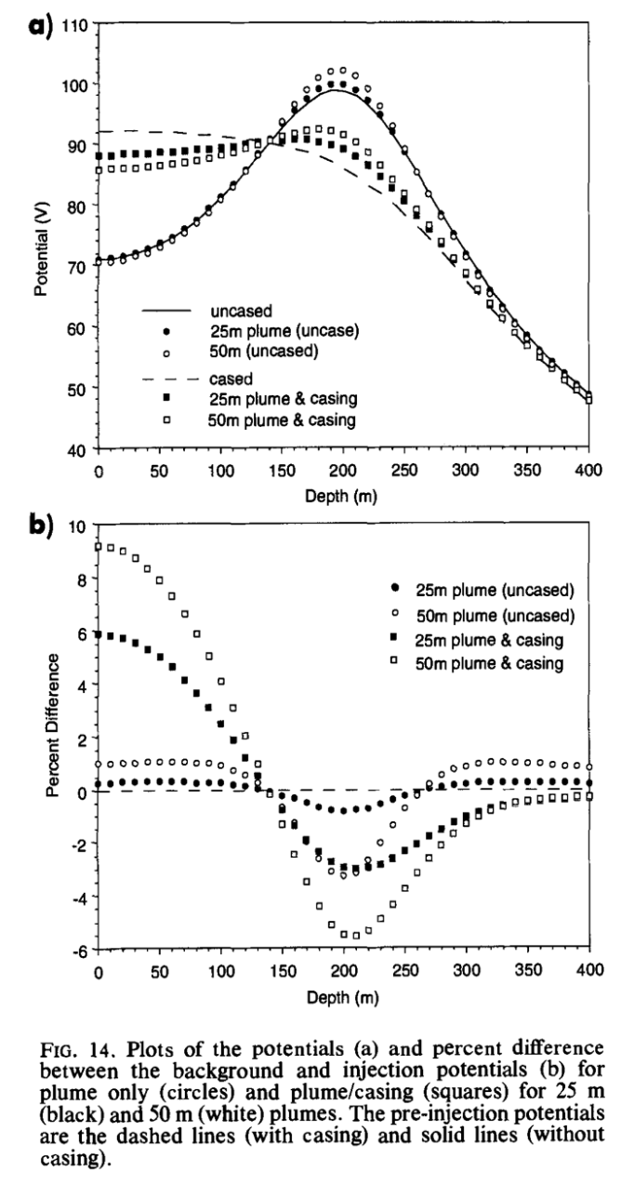
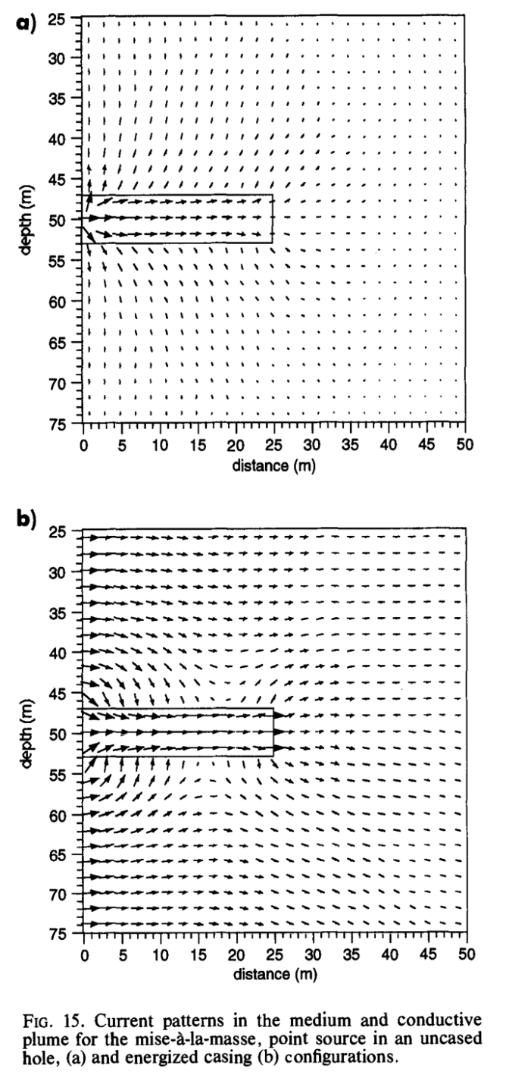
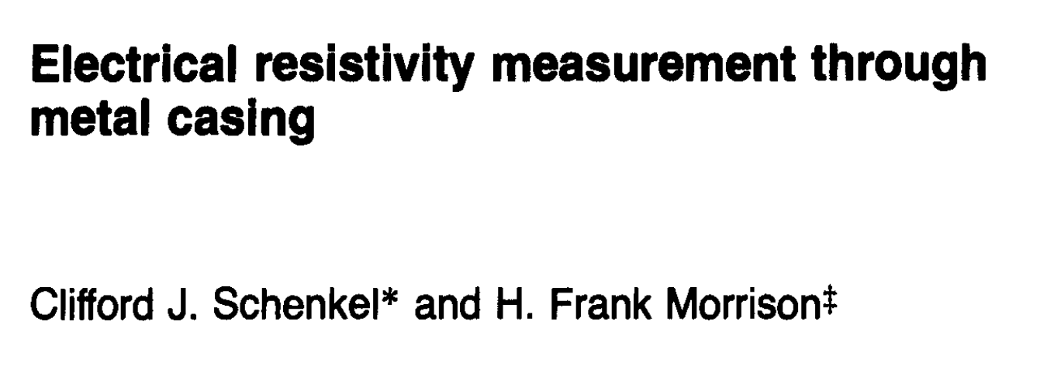
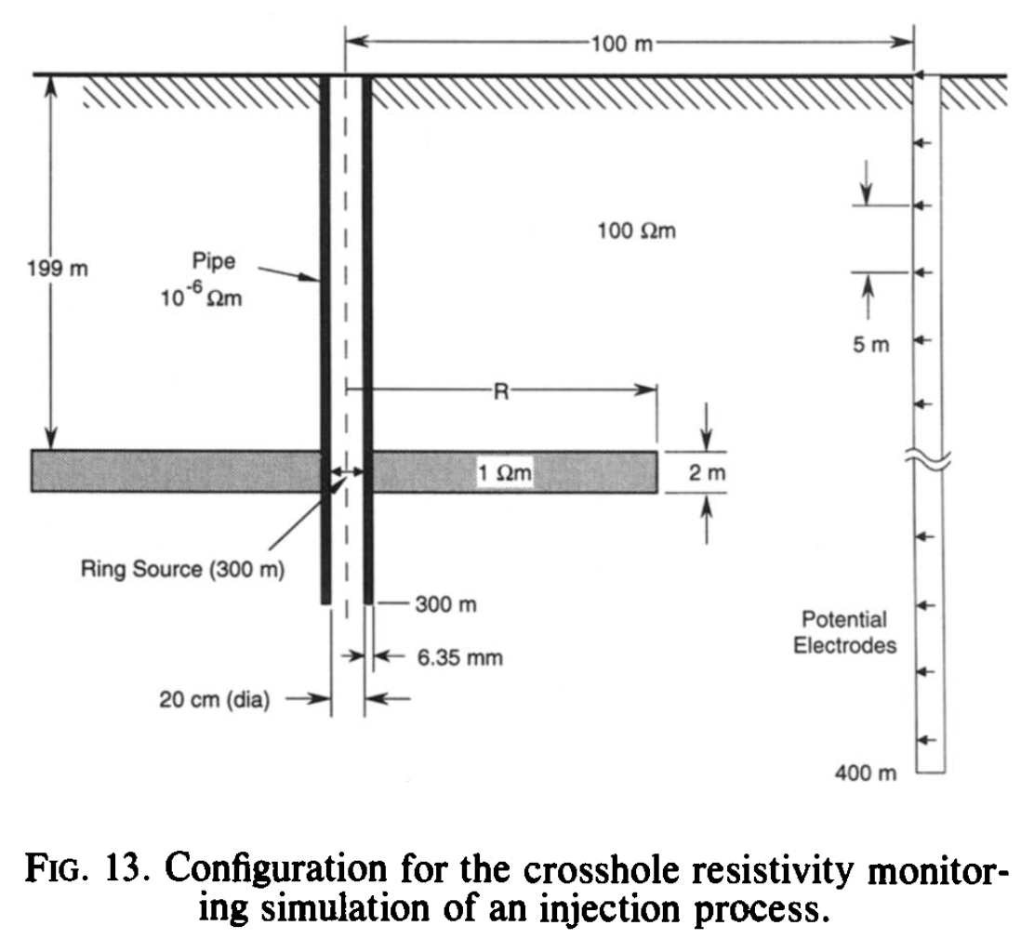

Slide 6
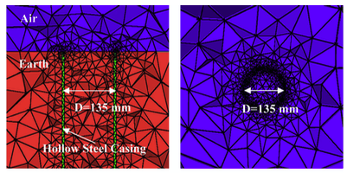
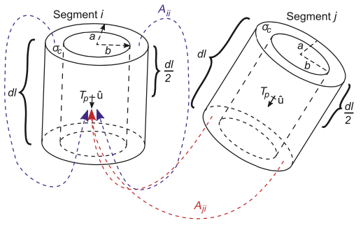
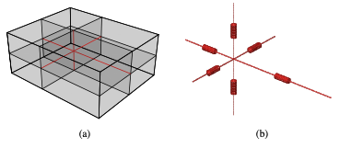
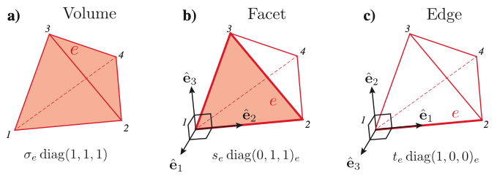
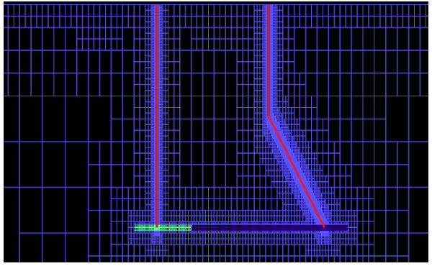
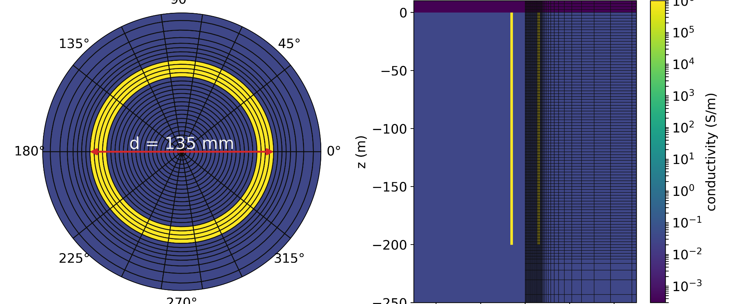
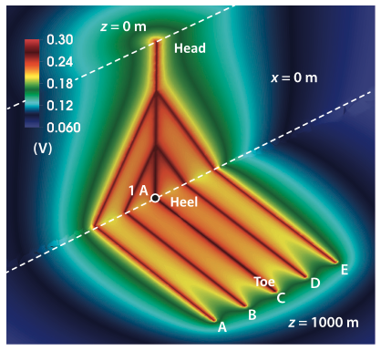
more recently… advances in modelling
highly refined meshes
method of moments
discretizing on edges, faces
Yang et al., (2016); Hu et al., (2022)
Um et al., (2015)
Tang et al., (2014), Kohnke et al., (2015) Patzer et al., (2017)
cylindrical meshes
Weiss, (2017)
Haber et al., (2016)
Heagy & Oldenburg (2019)

Slide 7
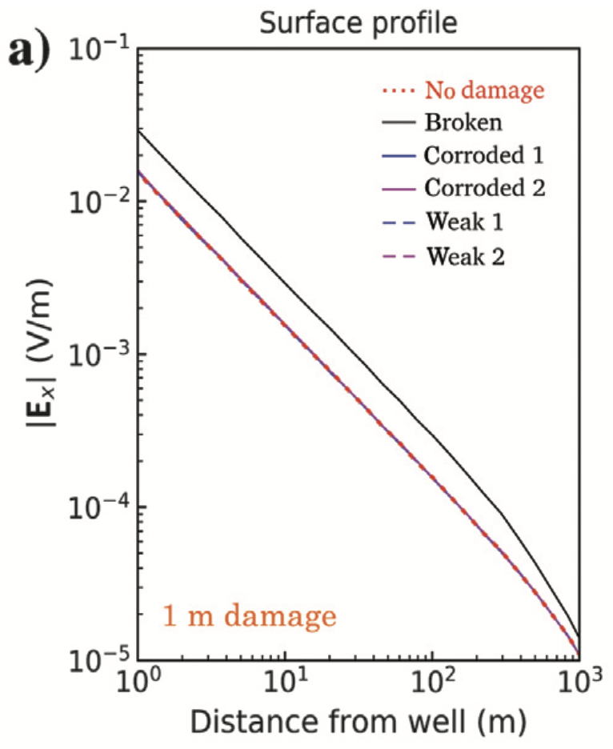
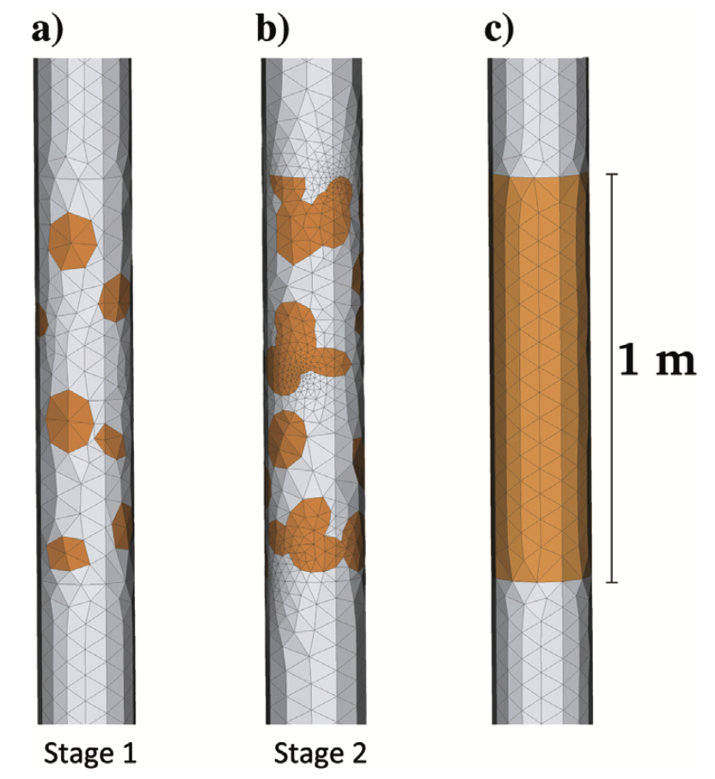
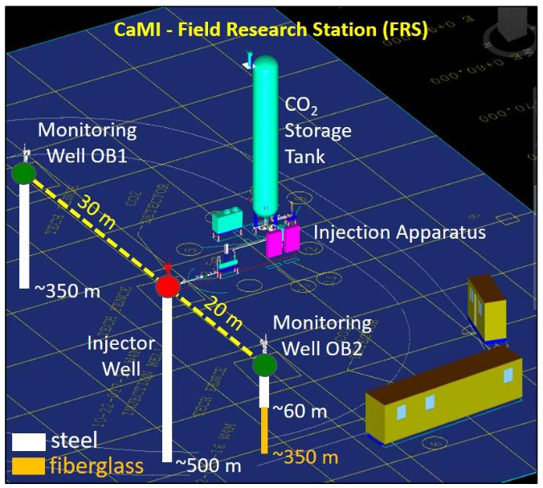
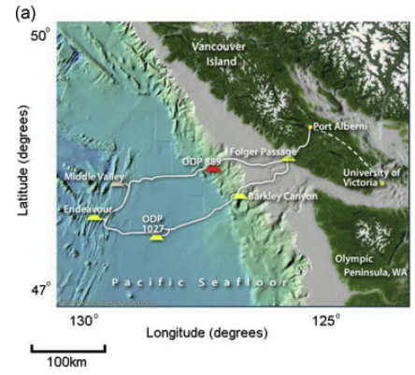
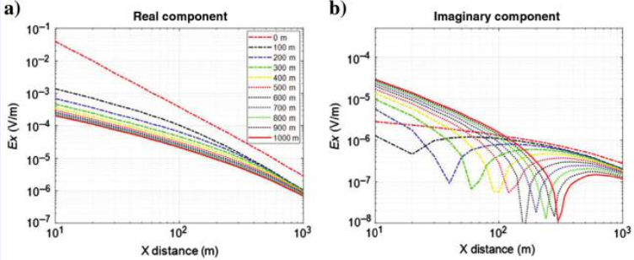
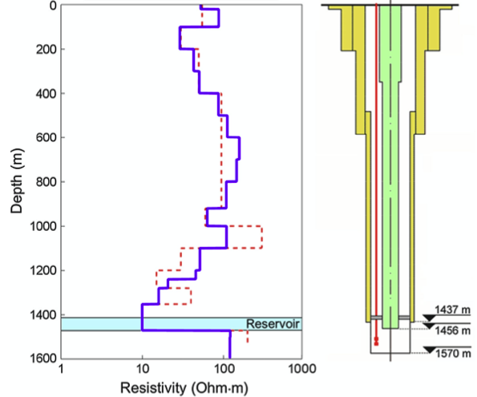
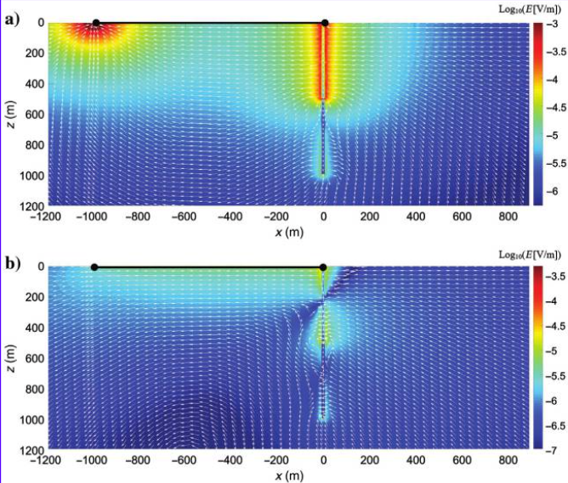
more recently… a number of applications
monitoring
casing integrity
CO₂
gas hydrates, hydrocarbons
Beskardes, et al, (2021); Wilt, et al, (2020)
Pardo et al., (2018), Cuevas & Pezzoli (2022); Swidinsky et al., (2023)...
Puzyrev et al., (2017); Um et al., (2020); Weiss et al., (2022) …

Slide 8
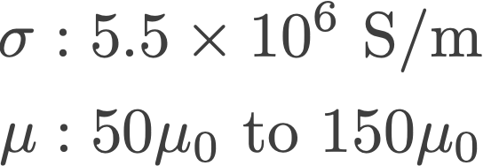
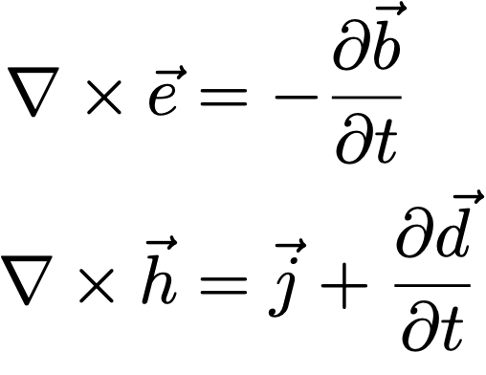
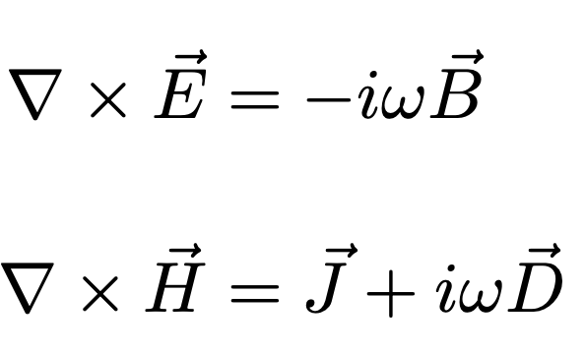
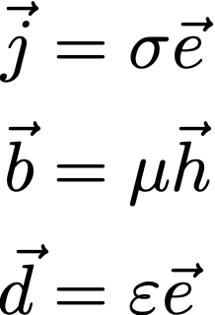
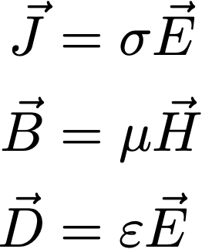
steel casings & electromagnetics
steel: highly conductive, magnetic
high conductivity:
helps channel currents to depth
strategies for simulating
magnetic permeability
time domain
frequency domain
Wu & Habashy (1994)
?

Slide 9
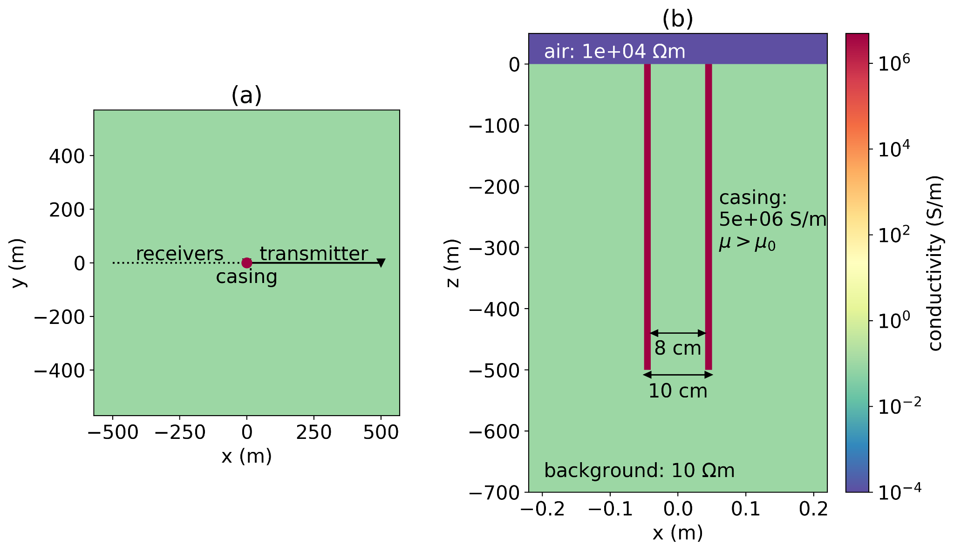
setup: grounded source experiment
simulate with SimPEG 3D cylindrical mesh

Slide 10
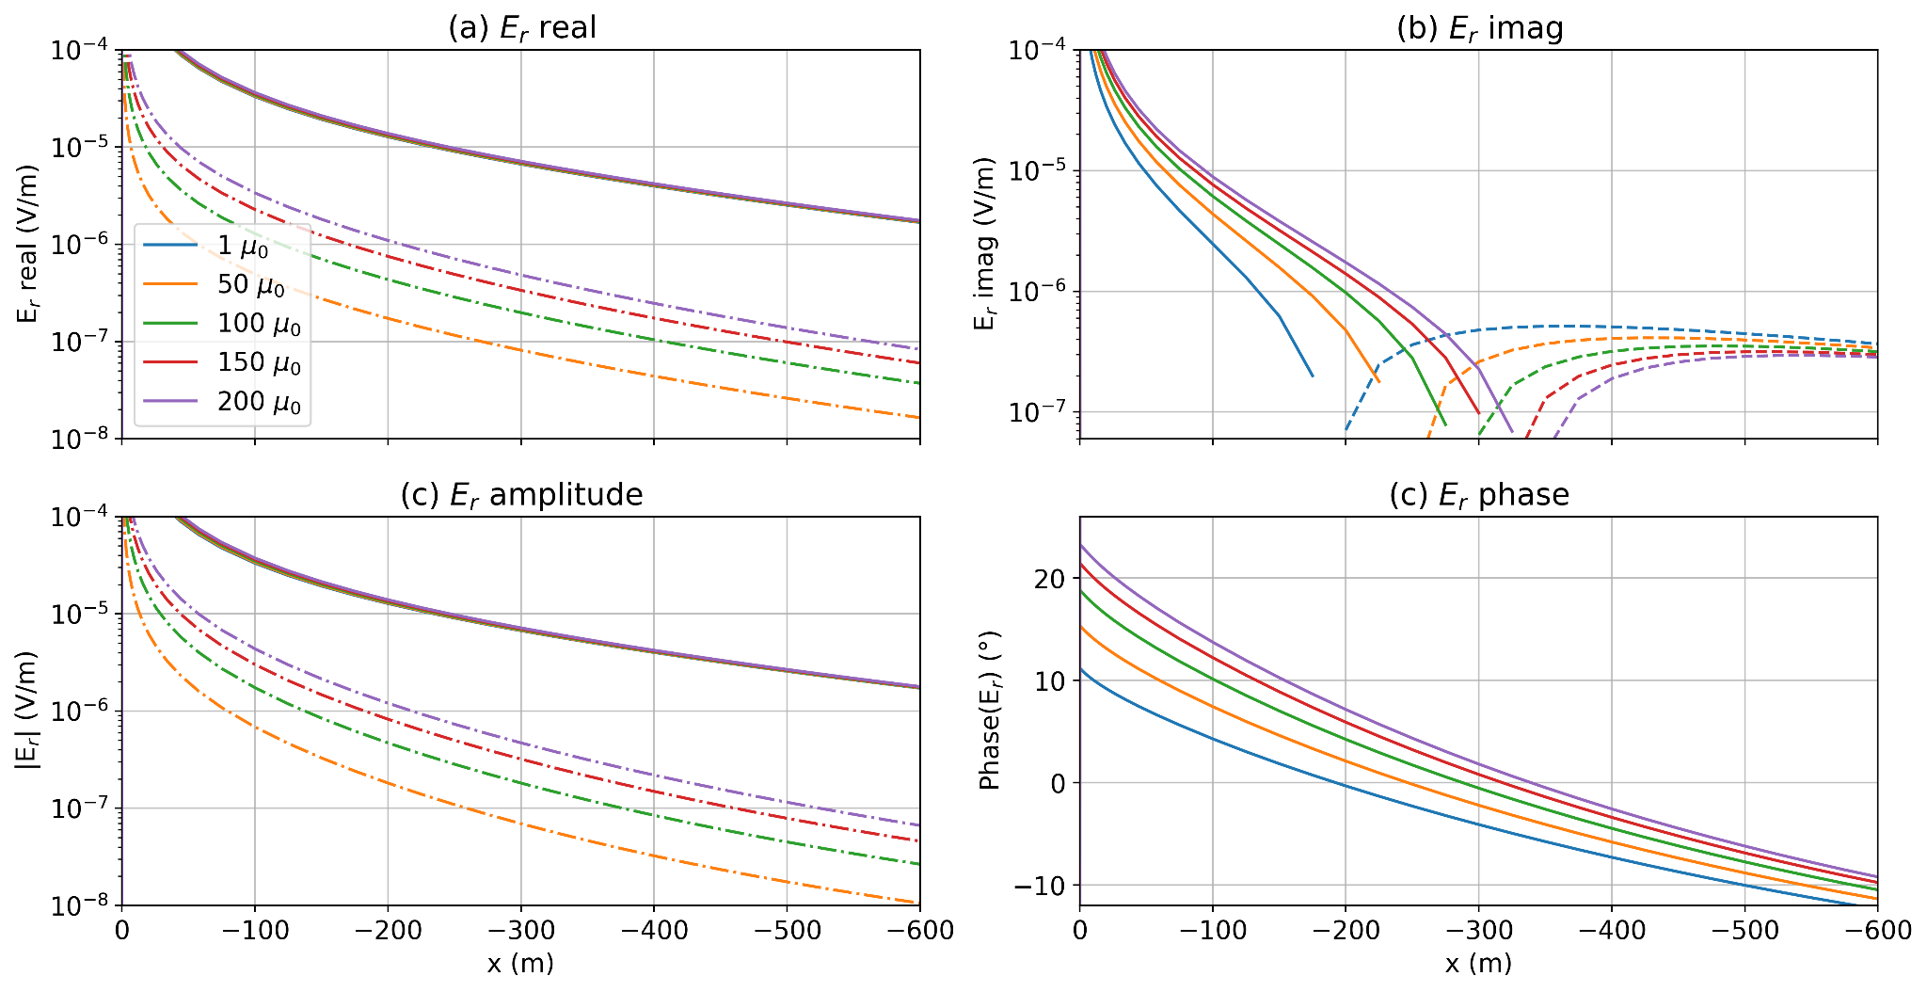
impacts of permeability on EM data
FDEM: 5Hz
difference from 𝜇₀

Slide 11
impacts of permeability on EM data
FDEM: 5Hz
difference from 𝜇₀
difference from 𝜇₀

Slide 12
impacts of permeability on EM data
FDEM: 5Hz

Slide 13
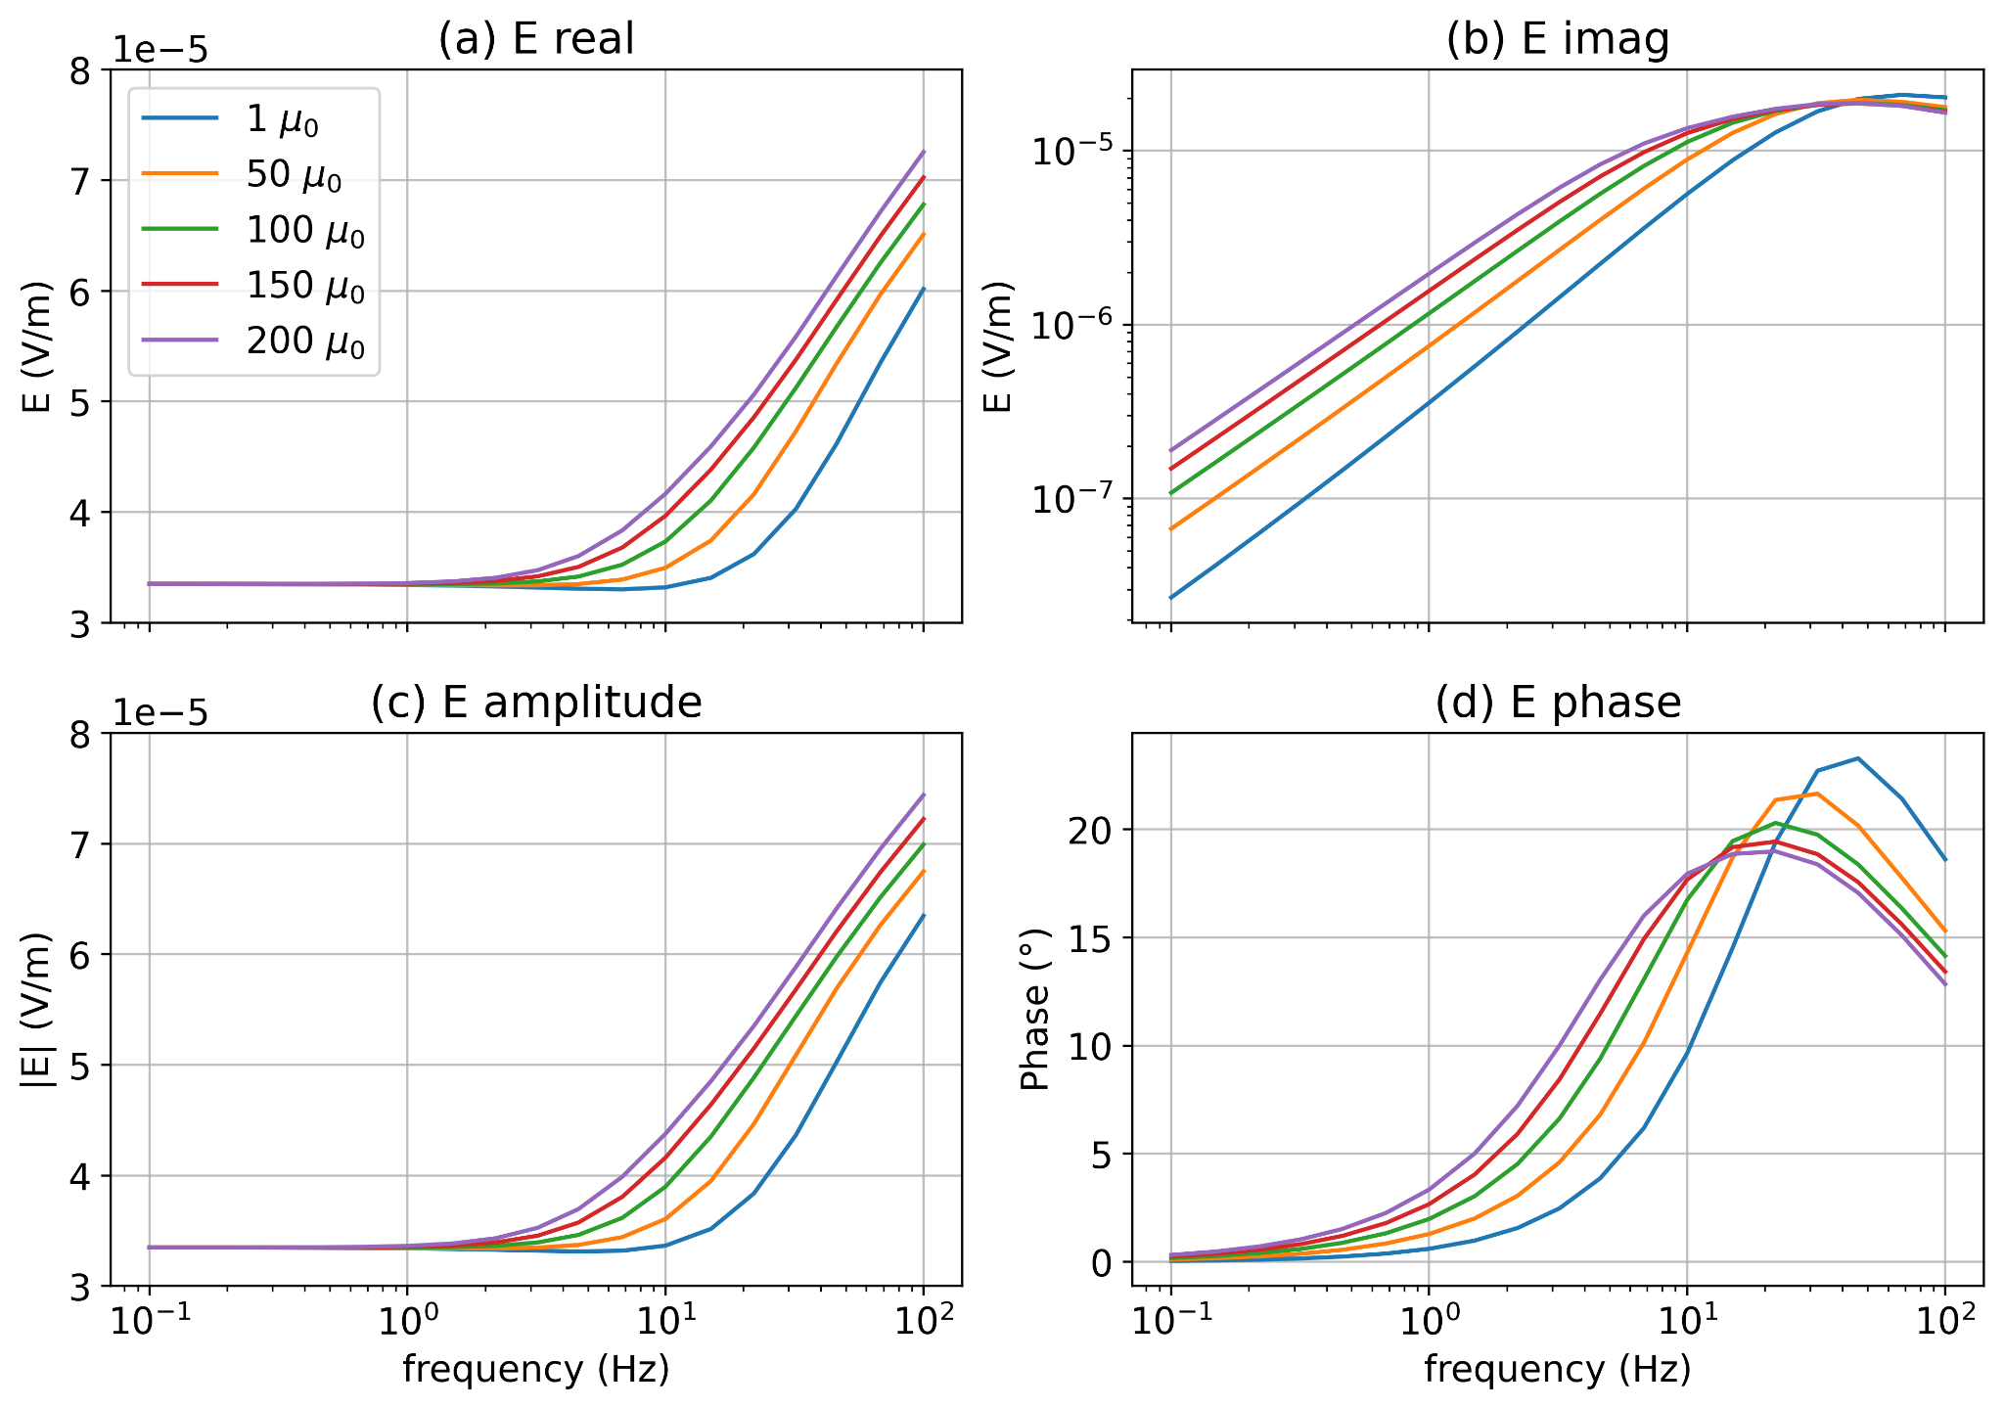
impacts of permeability on EM data
FDEM: 100m

Slide 14
impacts of permeability on EM data
FDEM: 100m
factor of ~2
factor of ~4
~20% difference
~7º difference
~20% difference

Slide 15
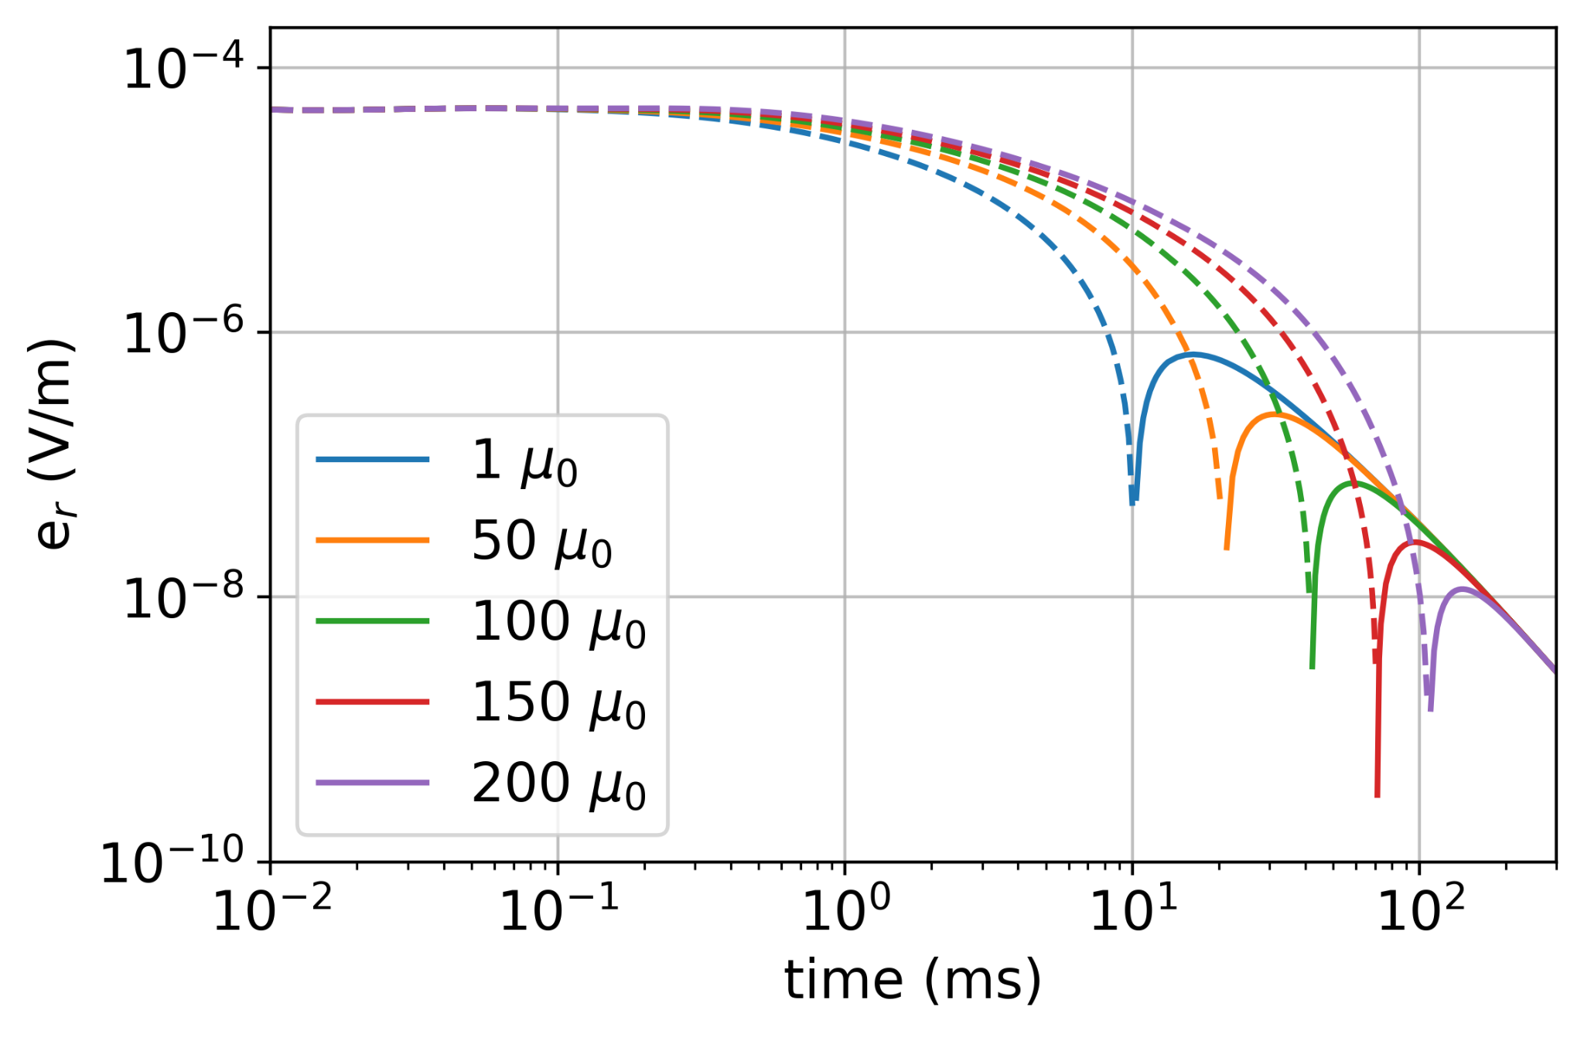
impacts of permeability on EM data
TDEM

Slide 16
magnetic permeability in electromagnetic experiments
In frequency domain
notable impact even at “low” frequencies
In time-domain
delays the decay
impacts of 𝜇 have been studied in other applications…

Slide 17
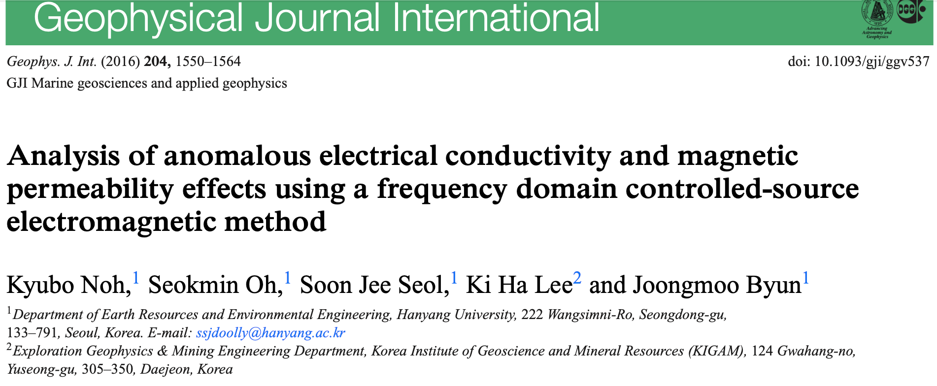
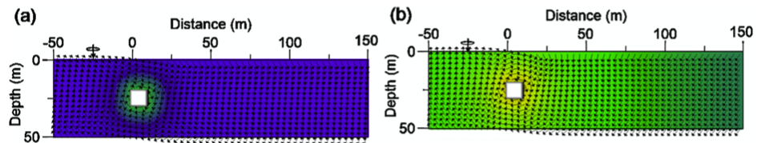
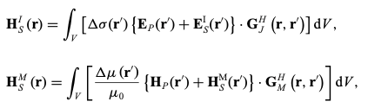
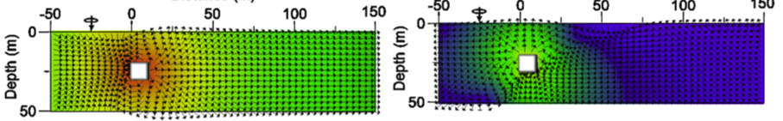
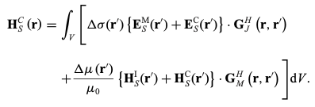
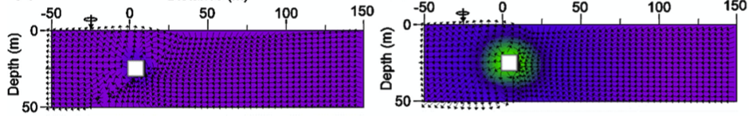
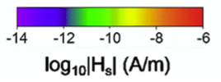
Noh et al., (2016)
Frequency domain, inductive sources
Use integral formulation to describe role of permeability in terms of
induction
magnetization
and coupling effects
anomalous real
anomalous imag
inductive
magnetization
coupling

Slide 18
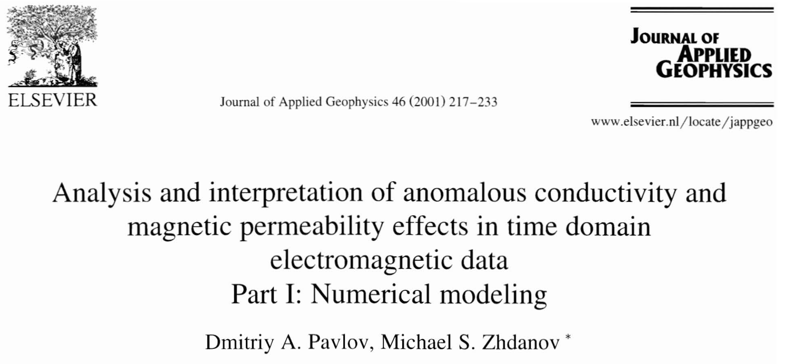
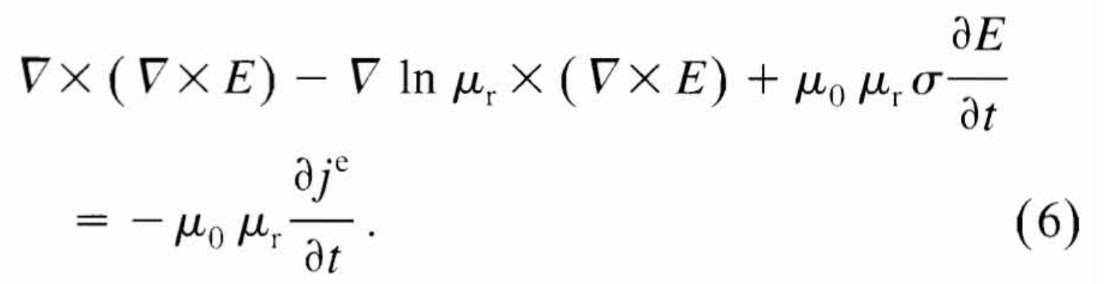
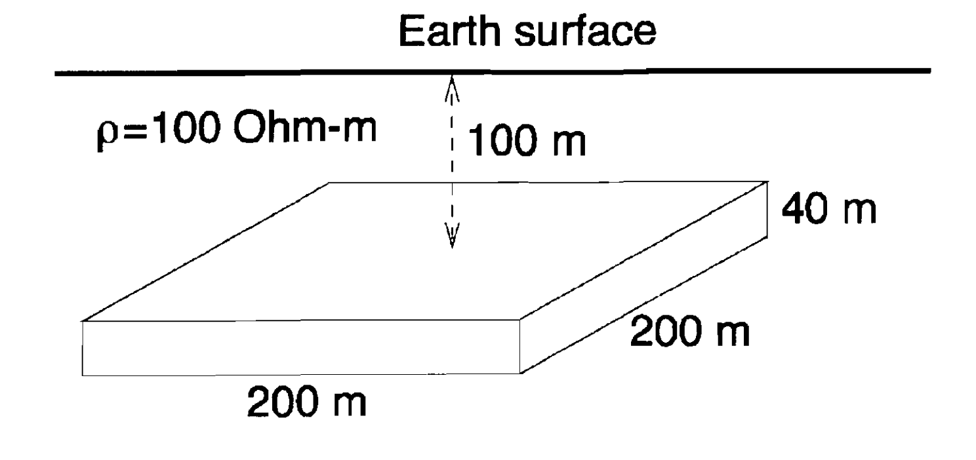
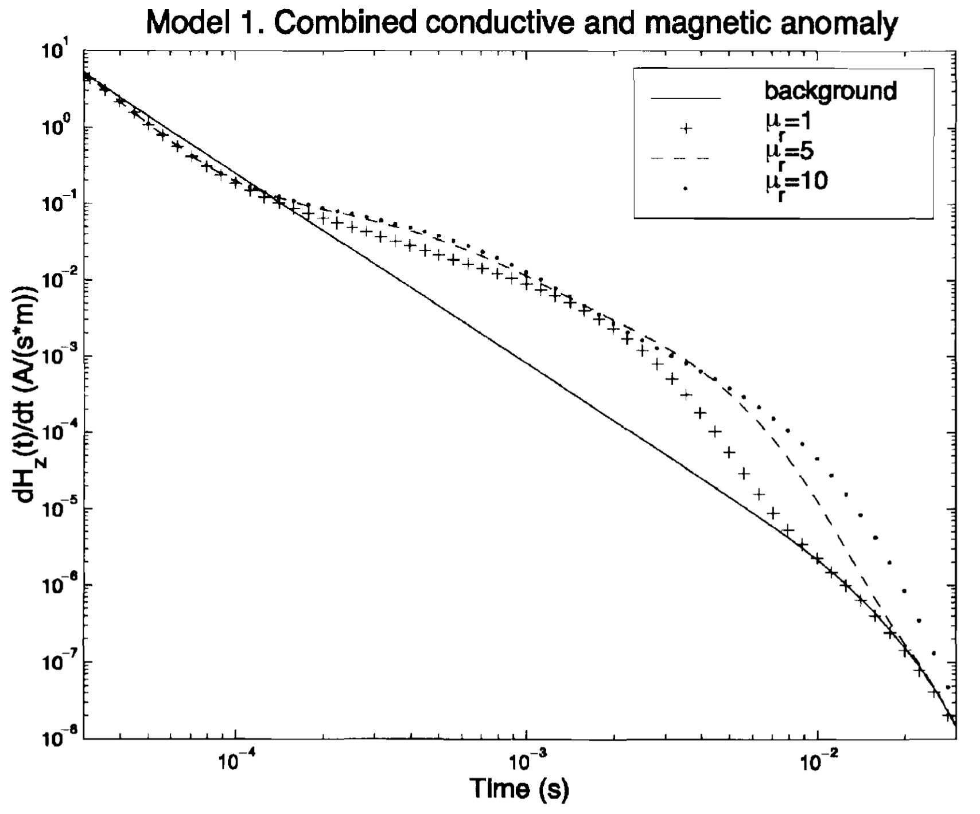
Pavlov & Zhdanov (2001)
Time domain, inductive sources
Rewrite the Maxwell’s equations
Two conclusions. Anomalous permeability…
prolongs anomalous TDEM response
increases response as compared to only conductive target
(1) contribution due to magnetization
(2) contribution to inductive component

Slide 19
magnetic permeability in electromagnetic experiments
In frequency domain
notable impact even at “low” frequencies
In time-domain
delays the decay
what about for grounded sources? interplay of high conductivity, permeability?

Slide 20
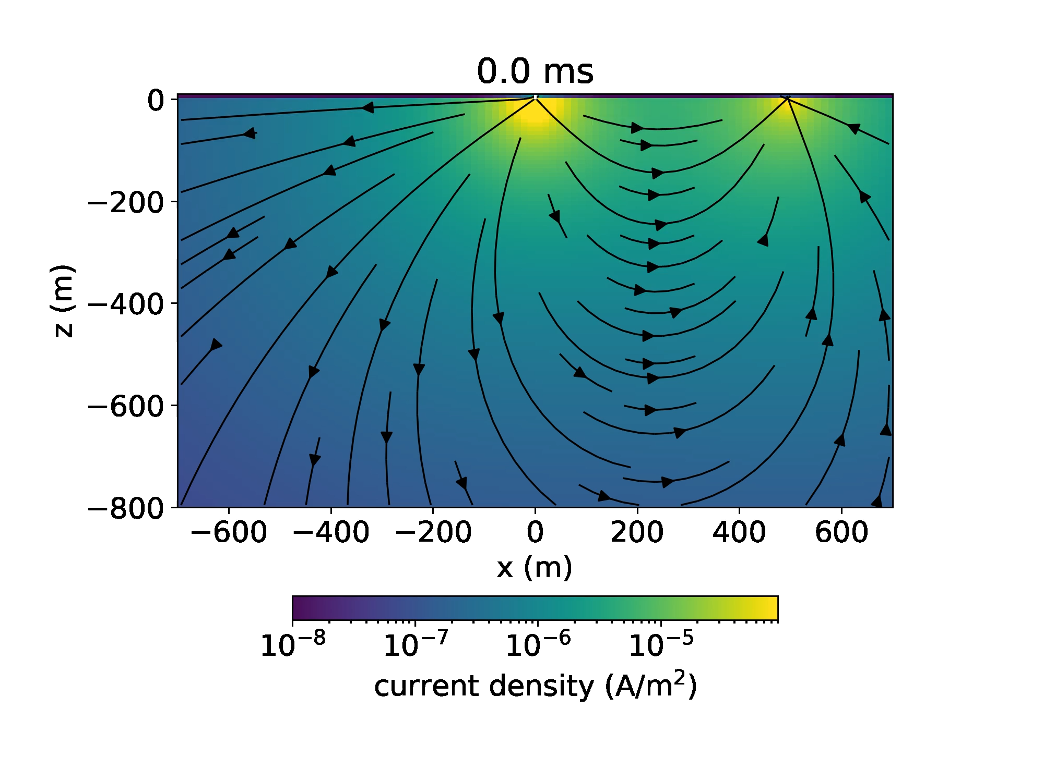
TDEM response: halfspace

Slide 21
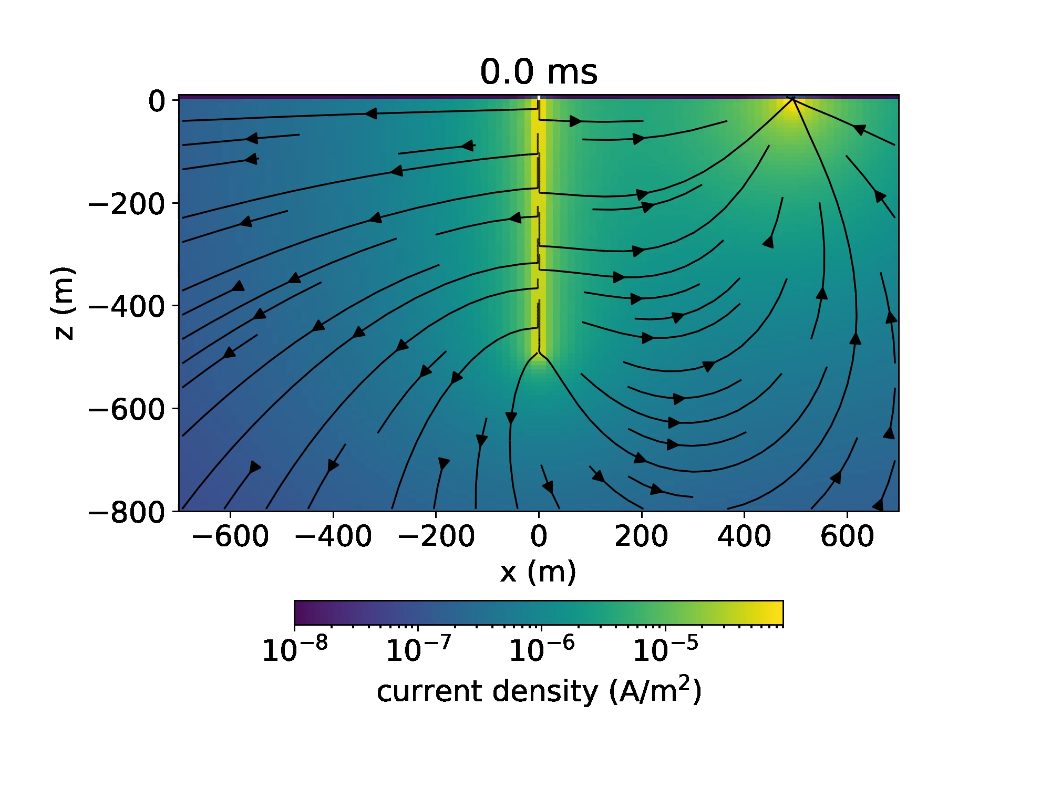
TDEM response: conductive casing

Slide 22
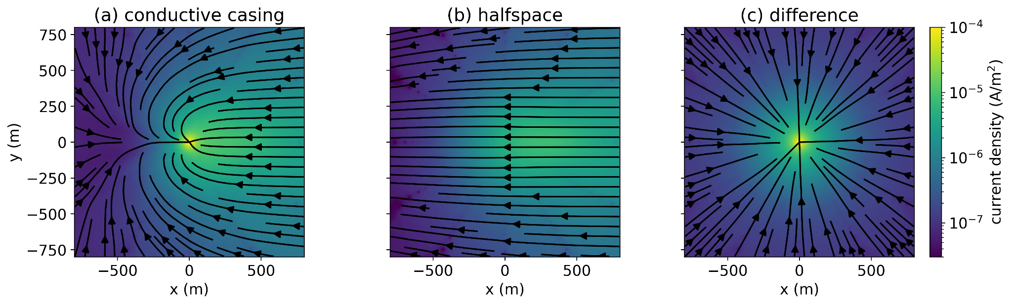
TDEM response: conductive casing
the zero-crossing in TDEM, FDEM responses…
due to geometry, currents channelling into casing
depth slices of currents

Slide 23
TDEM response: conductive, permeable casing
𝜎 = 5.5 x 10⁶ S/m
𝜇 = 150𝜇₀

Slide 24
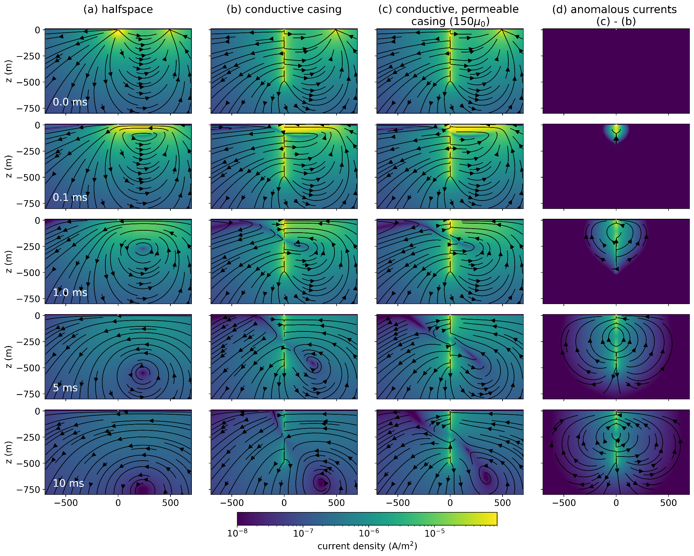

Slide 29

TDEM response: conductive, permeable casing
zooming in…

Slide 30

why do we have a poloidal current?
the cartoon explanation

Slide 31








why do we have a poloidal current?
start from Ampere’s law
use constitutive relation
vector identity
multiply by 𝜇
identity
away from the source

Slide 32
why do we have a poloidal current?
(1) magnetization
term
(2)
induction term

Slide 33
why do we have a poloidal current?
(1) magnetization
term
(2)
induction term
role of 𝜇 acts in same manner as 𝜎
enhances inductive component of response

Slide 34
why do we have a poloidal current?
(1) magnetization
term
(2)
induction term
non-zero only where 𝜇 changes (at the casing walls)
role… ???

Slide 35

by symmetry, magnetic field mostly rotational

Slide 36
b-field discontinuous, negligible on inner casing wall

Slide 37
negative radial x negative azimuthal = positive vertical

Slide 38
why do we have a poloidal current?
(1) magnetization
term
(2)
induction term
non-zero only where 𝜇 changes (at the casing walls)
role: contributes an upwards oriented magnetization current

Slide 39
why do we care?
(it’s interesting!)
magnetic permeability…
enhances inductive component of the response
introduces a magnetization current
as a result…
alters EM excitation
alters EM data
consider a test volume…

Slide 40

why do we care?

Slide 41
summary
magnetic permeability…
enhances inductive component of the response
introduces a magnetization current
as a result…
alters EM excitation & data
implications…
not equal to a simple scaling of conductivity
can’t be modelled by “equivalent” magnetic dipoles
questions for modelling in 3D
additional complication: 𝜇 usually not known…
but … we understand the physics and can simulate responses

Slide 42



thank you! questions?
Heagy, L.J., Oldenburg, D.W., 2023. Impacts of magnetic permeability on electromagnetic data collected in settings with steel-cased wells. Geophysical Journal International 234, 1092–1110. https://doi.org/10.1093/gji/ggad122
simpeg.xyz
lheagy@eoas.ubc.ca
bit.ly/heagy-2023-3dem
Heagy, L.J., Oldenburg, D.W., 2023. Impacts of magnetic permeability on electromagnetic data collected in settings with steel-cased wells. Geophysical Journal International 234, 1092–1110. https://doi.org/10.1093/gji/ggad122

Slide 44


Slide 45
FDEM response

Slide 46

FDEM currents
(real)

Slide 47

FDEM currents
(real - dc)

Slide 48

FDEM currents
(imag)

Slide 49

FDEM zoomed in (real)

Slide 50

FDEM zoomed in (real)

Slide 51
excitation in time

Slide 52


Slide 53
a more conductive background 1 S/m

Slide 54

More conductive background (1 S/m)
5 Hz

Slide 55


More conductive background (1 S/m)
x = 26, 100m

Slide 56

More conductive background (1 S/m)

